Slide 1
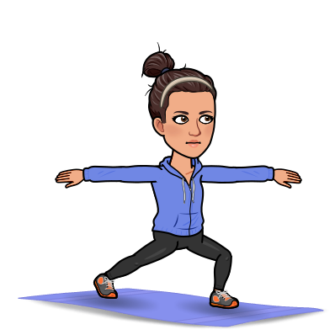
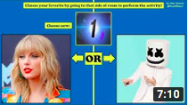
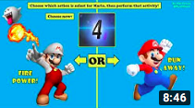
Daily physical activity is very important to help keep a healthy mind and body during this difficult time. Click on an image below to try a workout.
Healthy body = healthy mind
Fitness Fun - Mike Ginicola
PE at Home: Challenges - Mike Morris
Mindfulness and Feel Good Movement - Go Noodle
Click for more!

Slide 2
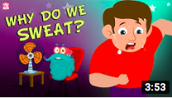
Daily physical activity is very important to help keep a healthy mind and body during this difficult time. Click on an image below to try a workout.
Healthy body = healthy mind
Our Bodies - Peekaboo Kidz
Our Bodies - SciShow Kids
Healthy Eating
Click here to Go Back to Beginning!

Slide 3
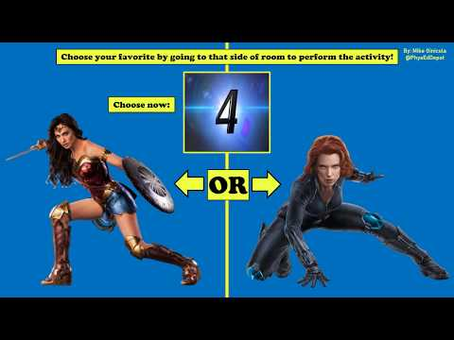
RETURN
TO

Slide 4
RETURN
TO

Slide 5
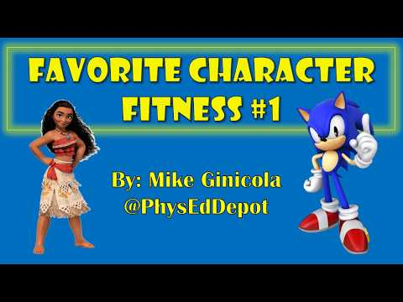
RETURN
TO

Slide 6
RETURN
TO

Slide 7
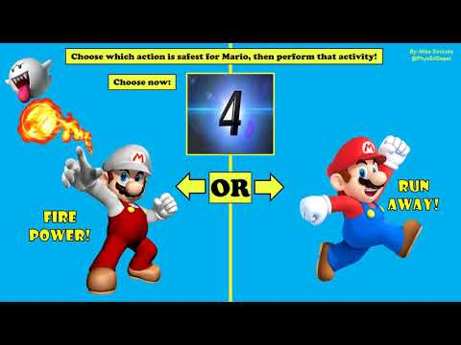
RETURN
TO

Slide 8
RETURN
TO

Slide 9
RETURN
TO

Slide 10
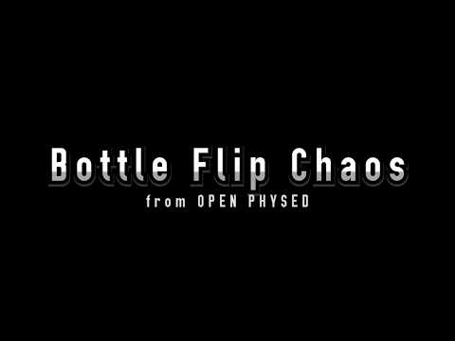
RETURN
TO

Slide 11
RETURN
TO

Slide 12
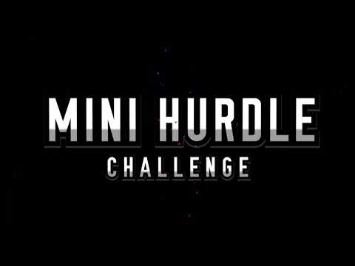
RETURN
TO

Slide 13
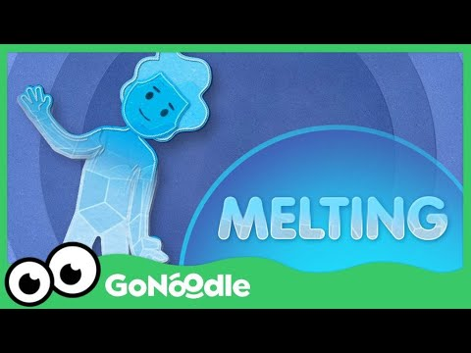
RETURN
TO

Slide 14
RETURN
TO

Slide 15
RETURN
TO

Slide 16
RETURN
TO

Slide 17
RETURN
TO

Slide 18
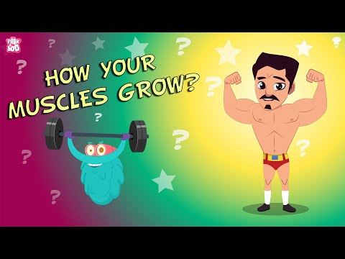
RETURN
TO

Slide 19
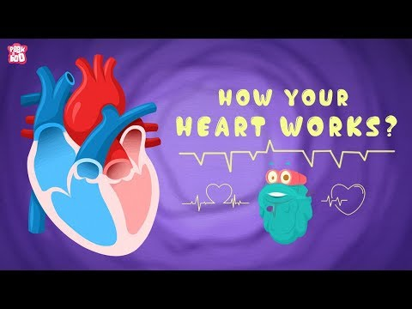
RETURN
TO

Slide 20
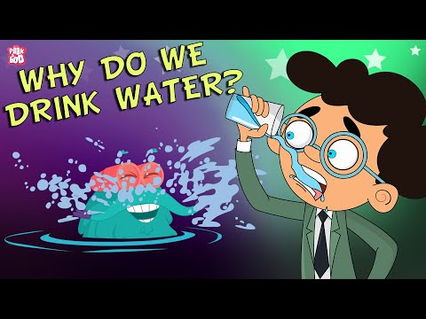
RETURN
TO

Slide 21
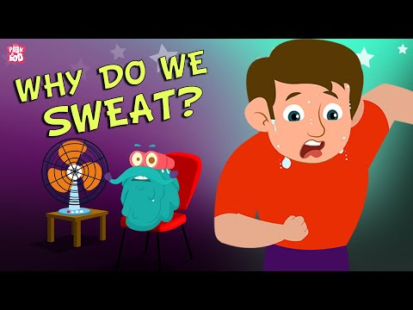
RETURN
TO

Slide 22
RETURN
TO

Slide 23
RETURN
TO

Slide 24
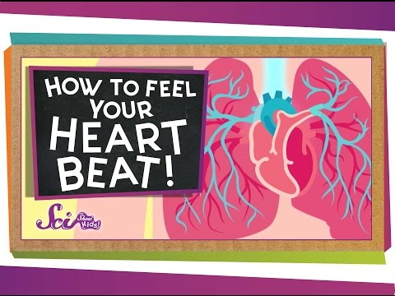
RETURN
TO

Slide 25
RETURN
TO

Slide 26
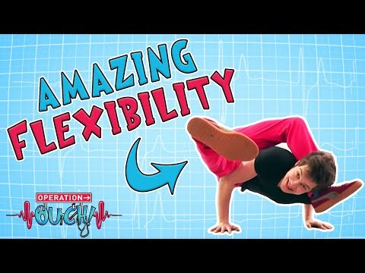
RETURN
TO

Slide 27
RETURN
TO

Slide 28
RETURN
TO

Slide 29
RETURN
TO

Slide 30
RETURN
TO

Slide 31
RETURN
TO

Slide 32
RETURN
TO

